Slide 1
19.01.21
La Famille Lesson 4:
Numbers 10-100
19.01.21
Today we are learning to:
Ask questions about the family
Count in tens from 10-100 in French

Slide 2
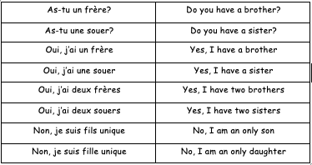
19.01.21
Review 1
First, we are going to review the family vocabulary from the previous lesson.

Slide 3
What does this mean in English?

Slide 4
Answers
Do you have a brother?
Do you have a sister?

Slide 5
What does this mean in English?

Slide 6
Answers
Yes, I have a brother.
Yes, I have two brothers.

Slide 7
What does this mean in English?

Slide 8
Answers
Yes, I have a sister.
Yes, I have two sisters.

Slide 9
What does this mean in English?

Slide 10
Answers
No, I am an only son.
No, I am an only daughter.

Slide 11
19.01.21
Review 2
Second, we are going to review the numbers 1-10.

Slide 12
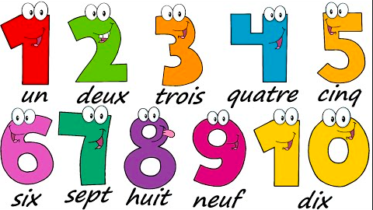
19.01.21
Review 2
Watch and listen to the Numbers 1-10 YouTube video: https://www.youtube.com/watch?v=woqBQG7LG8s

Slide 13
19.01.21
Review 2
Now have a go at counting from 1-10 in French on your own.

Slide 14
Today’s Vocabulary
19.01.21
Today we are going to learn to count in tens from 10-100 in French.

Slide 15
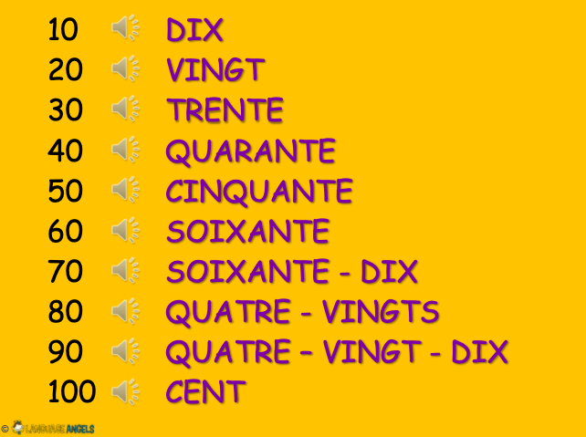
Today’s Vocabulary
19.01.21
Watch and listen to the Numbers 10-100 YouTube video: https://www.youtube.com/watch?v=e8FYwfesR54

Slide 16
19.01.21
Review 2
Now have a go at counting in tens from 10-100 in French on your own.

Slide 17
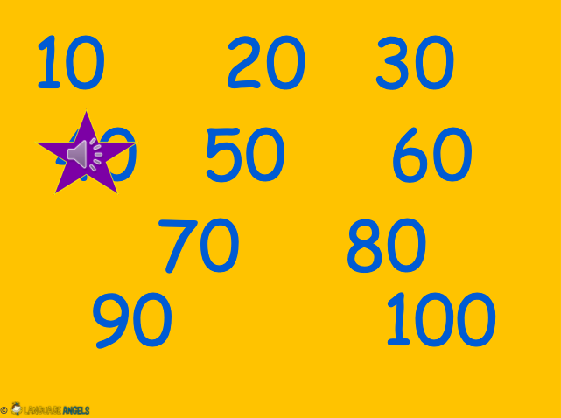
What number is the star covering?
19.01.21

Slide 18
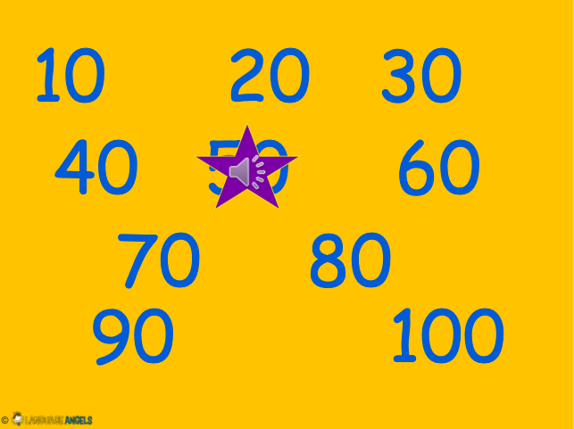
What number is the star covering?
19.01.21

Slide 19
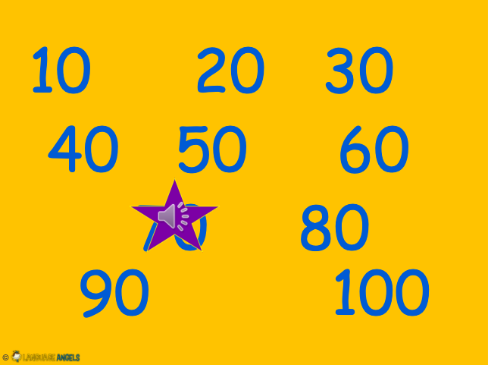
What number is the star covering?
19.01.21

Slide 20
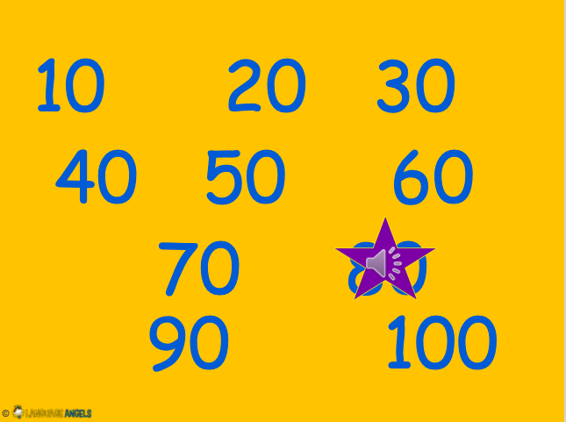
What number is the star covering?
19.01.21

Slide 21
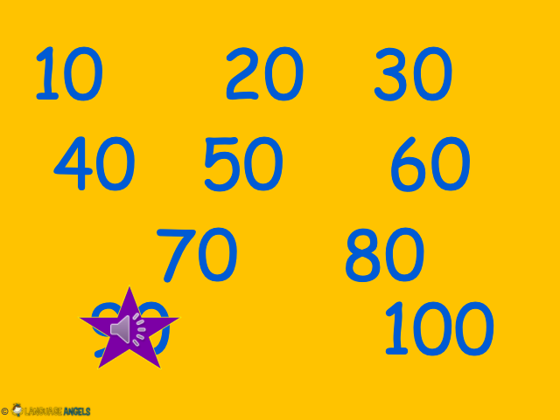
What number is the star covering?
19.01.21

Slide 22
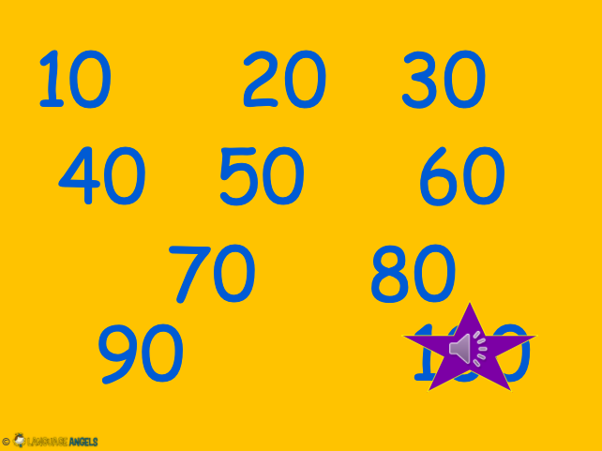
What number is the star covering?
19.01.21

Slide 23
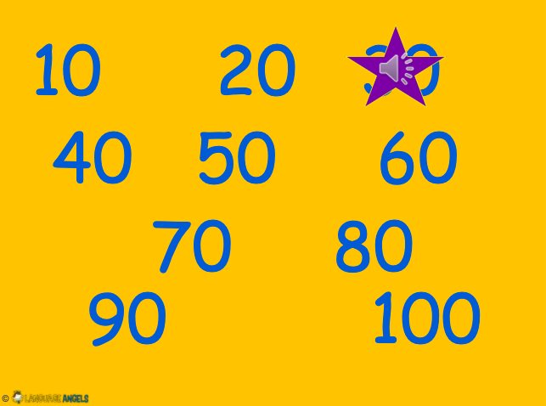
What number is the star covering?
19.01.21

Slide 24
What number is the star covering?
19.01.21

Slide 25
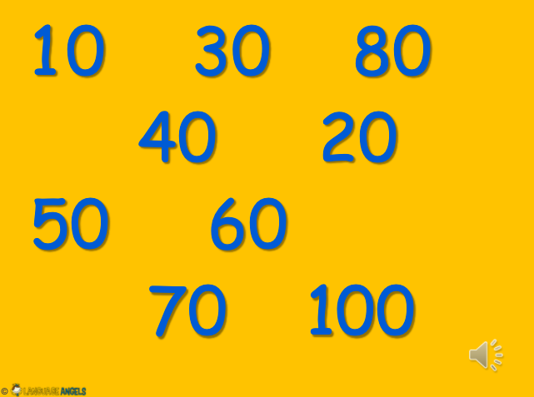
What number is missing?
19.01.21

Slide 26
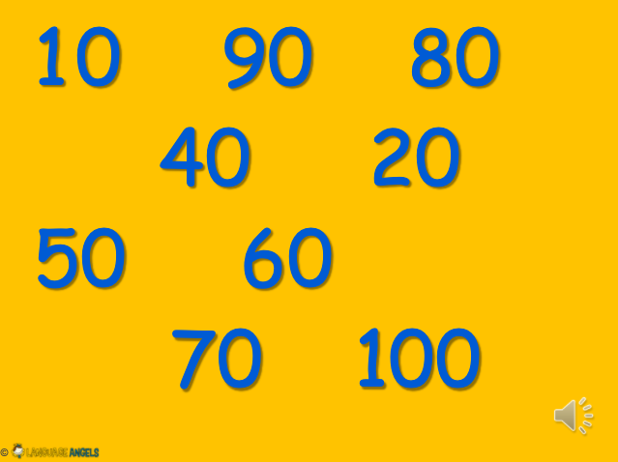
What number is missing?
19.01.21

Slide 27
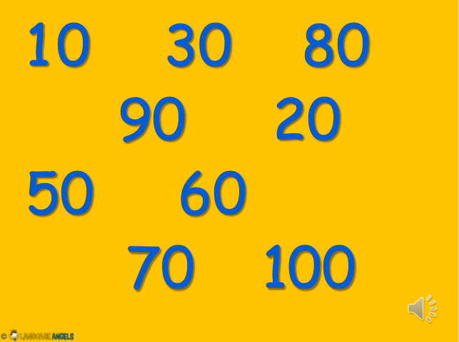
What number is missing?
19.01.21

Slide 28
What number is missing?
19.01.21

Slide 29
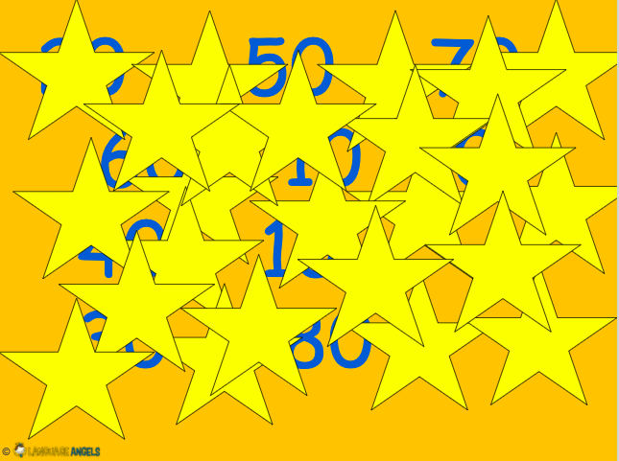
What numbers can you find?
19.01.21

Slide 30
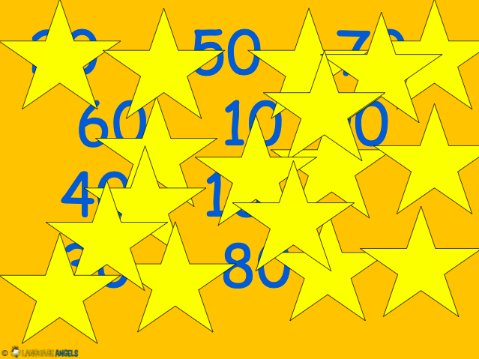
What numbers can you find?
19.01.21

Slide 31
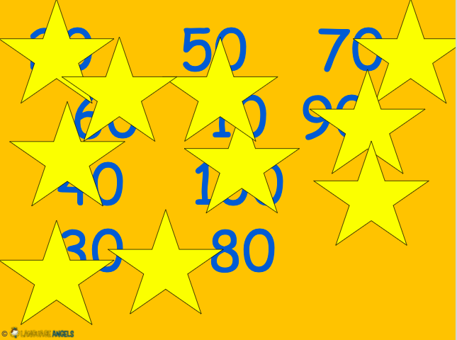
What numbers can you find?
19.01.21

Slide 32
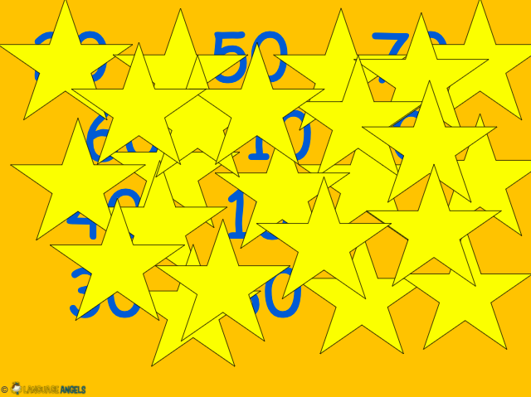
What numbers can you find?
19.01.21

Slide 33
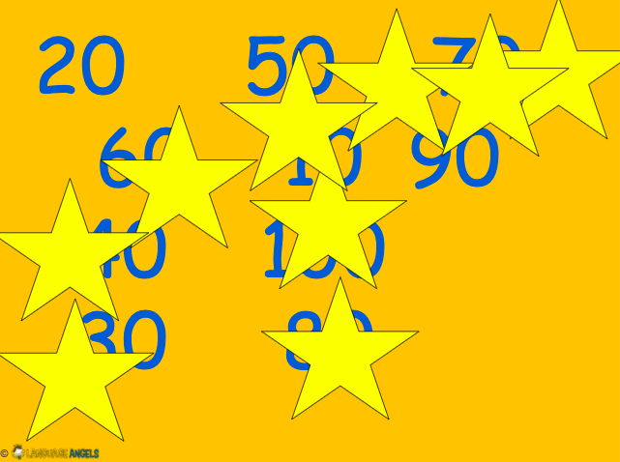
What numbers can you find?
19.01.21

Slide 34
What numbers can you find?
19.01.21

Slide 35
Task
19.01.21
Complete the 10-100 crossword.

Slide 36
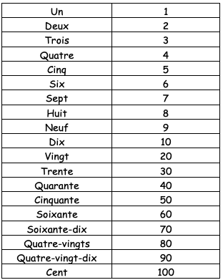
Today’s Vocabulary Review
19.01.21
Can you say the numbers 1-10 and 10-100 in French?

