Slide 1
Voices in the Park
English
19.01.21

Slide 2
Speaking and Listening
Click here to watch newsround
Watch Newsround.
What did you find out?
Did anything puzzle you?
Would you like to discuss something more or find out more about it?

Slide 3
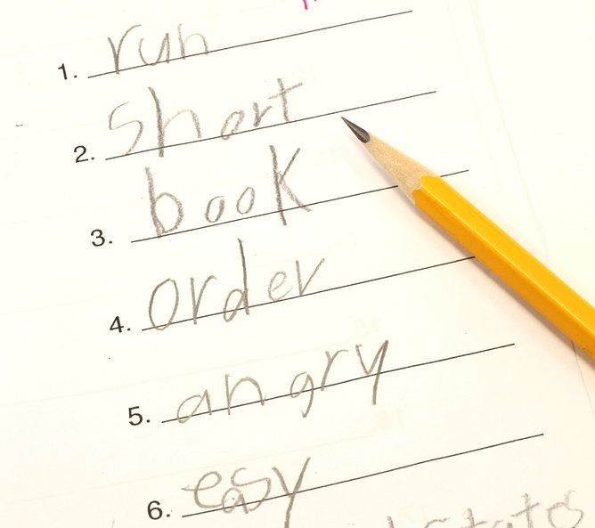
SPaG starter
Spelling rule breakers!
Read the spelling rule.
Read the words.
Which is the rule breaker?

Slide 4
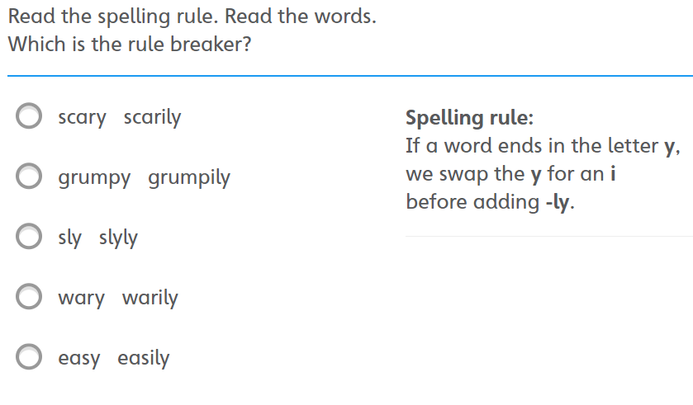
Spelling rule breakers

Slide 5
Spelling rule breakers - Answer
The rule breaker is sly.
We don’t swap the y for i if the root word has only one syllable.

Slide 6
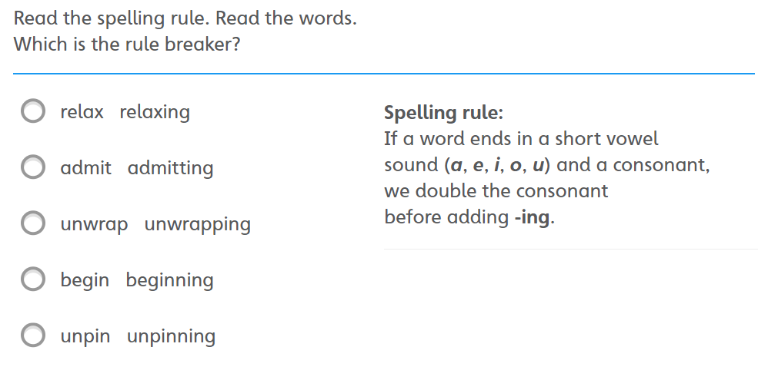

Slide 7
Spelling rule breakers - Answer
The rule breaker is relax.
The letter x is never doubled.

Slide 8
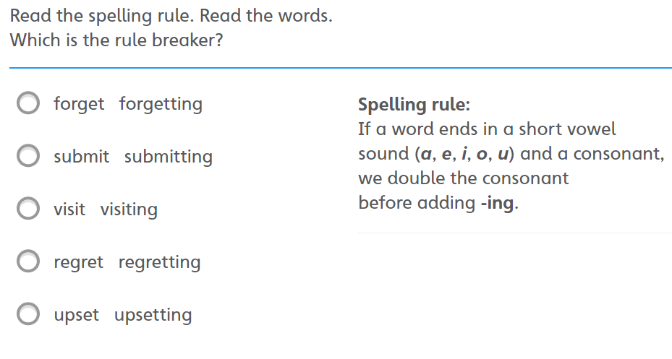

Slide 9
Spelling rule breakers - Answer
The rule breaker is visit.
The consonant is not doubled if the syllable is unstressed.

Slide 10
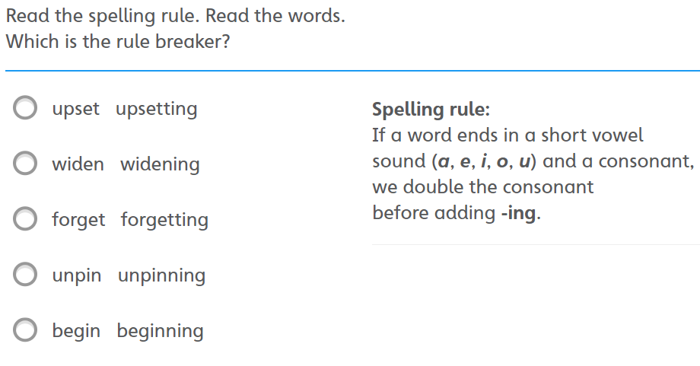

Slide 11
Spelling rule breakers - Answer
The rule breaker is widen.
The consonant is not doubled if the syllable is unstressed.

Slide 12
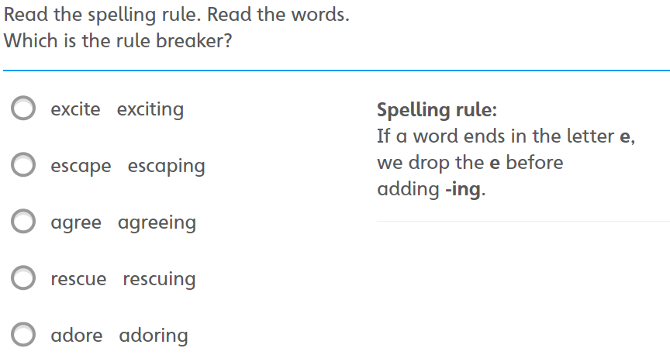

Slide 13
Spelling rule breakers - Answer
The rule breaker is agree.
We don’t drop the e if the root word ends in ee.

Slide 14
I can infer how a character is feeling

Slide 15
Read / listen to the story or use the pdf copy on Google Classroom
https://www.youtube.com/watch?v=58kla7Ghxas

Slide 16
Illustrations
Anthony Brown who wrote
‘Voices in the Park’ also
illustrated the book.
Today we are going to look at how he uses the illustrations to help tell the story and give clues about the characters

Slide 17
Questions about pictures
Look closely at the pictures which go with each voice.
What do you notice? Think back to the lesson yesterday.
Are they the same?
How are they different?
Why do you think they are different?

Slide 18
Task: Looking for clues!
Anthony Browne has deliberately given the reader extra clues to make us think.
Now, choose a picture from the story and look at it really closely as if you were a detective!
Is there anything strange or interesting?
Why do you think it is there?
Think about what is happening in that part of the story. Whose voice it belongs with and how that character is feeling.
Record your ideas.

Slide 19
Questions
Find the questions that you thought of on Friday.
These are the questions that you would like to ask one of the characters.
Discuss the questions and use the illustrations to back up your answers.

Slide 20
Review
How do illustrations give us clues about how a character is feeling?

