Slide 1
English
Poetry
Thursday 4th March

Slide 2
Speaking and listening
https://www.bbc.co.uk/newsround/news/watch_newsround
Watch Newsround.
What did you find out?
Did anything puzzle you?
Would you like to discuss something more or find out more about it?

Slide 3
SPaG Starter
I can recognise and spell words with the s sound spelt sc
Write one perfectly punctuated sentence about the Creeper

Slide 4
Words with the s sound spelt sc choose the correct word.

Slide 6
I can write a shape poem

Slide 7
Acrostic poem
Yesterday we wrote an acrostic poem. What does the structure look like?

Slide 8
Acrostic Features
What did you notice?
Poetic devices may be used.
The first letter of each line spells out the poem’s theme vertically – what’s this one about?
alliteration
simile
I
C
E
C
R
E
A
M
It’s my favourite food
Cold as the inside of a fridge
Every sunny day
Can’t wait
Running to the van
Empty out the money
‘Any sauce on that, love?’
Mmmmmm, yummy!
Lines can be different lengths

Slide 9
Shape Poems
Can you and a partner guess what these poems are describing?
Hint: You can use the words and the shape of the words to help you.
They glide across
the golden grass
gathering goblins and
gathering grasshoppers.
They giggle as they
glide above
the ground.
Reveal a Hint

Slide 10
Shape Poems
Can you and a partner guess what these poems are describing?
Softly, it falls silently from the sky.
It is so silvery, small and sudden.
Slowly you slip and slide as you sled
your way through its silky secrets.
Hint: You can use the words and the shape of the words to help you
Reveal a Hint

Slide 11
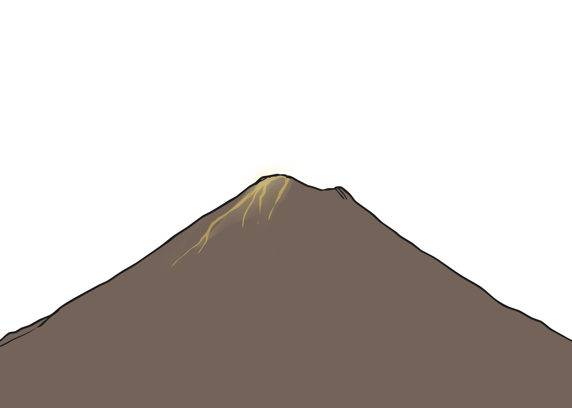
Shape Poems
Can you and a partner guess what these poems are describing?
Hint: You can use the words and the shape of the words to help you
Reveal a Hint
A huge rock that
rumbles and roars, wrecking the
ground all around it. It shoots sizzling, steaming, scorching lava like a monster spitting out hot liquid into the air. Like a smoking dragon, it finally starts to calm down. The chaos stops and it goes back to being a deadly and dangerous rock.

Slide 12
What is a Shape Poem?
A shape poem is a poem that describes an object, person or animal.
The special thing about a shape poem is that the words of the poem form the shape of the object, person or animal being described.
Shape poems don’t have to rhyme!
Shape poems can use full stops and capital letters like sentences.
Shape poems often use alliteration or similes.

Slide 13
The Features of a Shape Poem
What did you notice about the shape poems we looked at?
Each line can be a different length or be curved to form the shape of the object that is being described.
Full stops and capital letters are used just like you would use in sentences.
A
huge rock
that rumbles
and roars, wrecking
the ground all around it.
It shoots sizzling, steaming, scorching lava
like a monster spitting out hot liquid into the air.
Like a smoking dragon, it finally starts to calm down.
The chaos stops and it goes back to being a deadly and dangerous rock.
sizzling, steaming, scorching
like a monster
Like a smoking dragon,
Alliteration can be used – this is lots of words
in a row beginning with the same letter.
Similes can be used – this is where we use the words ‘like’ or ‘as’ to compare two things to each other.
The lines don’t have to rhyme.

Slide 14
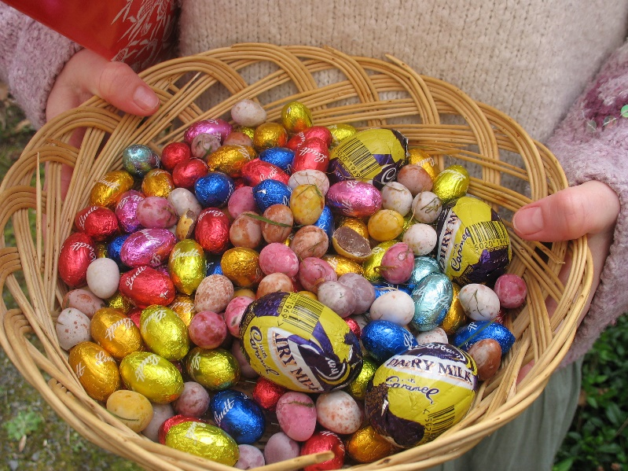
Let’s Try it!
First, let’s choose something to describe with a spring theme. Let’s choose… Easter eggs!
Next, we need to brainstorm all the adjectives or phrases we can think of to describe Easter eggs…
exciting
Can you think of anymore?
chocolatey
delicious
a basket of treasure waiting to be gobbled
enticing
with filling as gooey as mud
multi-coloured

Slide 15
Let’s Try it!
Here are some lines written using the adjectives and phrases that we brainstormed. Oh no, they’re all mixed up! Can you put them into the right order to make the shape of the Easter egg? Use the length of the lines and the punctuation to help you.
excitingly edible. I choose
reach my nose and tease my taste
one and peel it carefully like
A basket of
chocolatey filling, as gooey
So elegant, enticing and
and dark as mud.
multi-coloured treasure.
Click here for answers.
an orange. Sweet smells
buds. I discover a delicious,

Slide 16
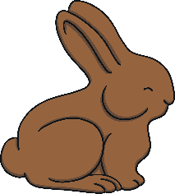
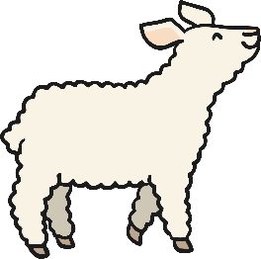
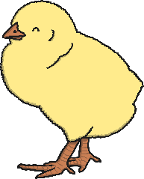
Ideas
Let’s make a shape poem describing spring objects or animals! Think of some words or phrases to describe the objects below.
a sign of spring
happy trumpets
hollow
crunchy
daffodil
chocolate bunny
floppy ears
bright
cheerful
delicious
bleating
fluffy
as yellow as sunshine
lamb
like a soft cloud
chick
chirruping
as fluffy as candy floss
tiny
Click here for answers

Slide 17
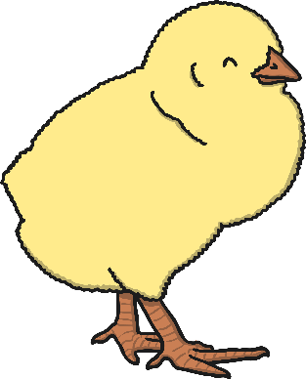
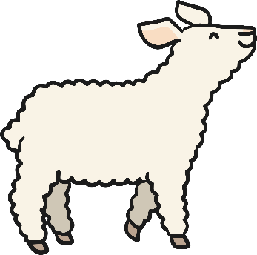
Task
Now, choose one object or animal.
Using the ideas you brainstormed before and an outline of the object or animal you have chosen, create your shape poem.
Remember to stay inside the lines of the picture, starting a new line when you get close to the edge.
Don’t forget to use full stops and capital letters.
Try to use alliteration or similes if you can.
This will make your shape poem more exciting and descriptive.

