Slide 1
I can subtract fractions (recap)
03.03.21

Slide 2
Vocabulary
Fraction
Amount
Whole
Numerator
Denominator
Subtract
Subtraction

Slide 4
1) 5 $−$ 3 $=$
5 thousands $−$ 3 thousands $=$
2) What is the difference between 9 and 3?
3) When adding fractions, add the
and keep the the same.
4) $\frac{\text{3}}{\text{9}}$ $=$ $\frac{\text{1}}{\text{3}}$ $\frac{\text{6}}{\text{10}}$ $=$ $\frac{\text{3}}{\text{5}}$

Slide 5
1) 5 $−$ 3 $=$
5 thousands $−$ 3 thousands $=$
2) What is the difference between 9 and 3?
3) When adding fractions, add the
and keep the the same.
4) $\frac{\text{3}}{\text{9}}$ $=$ $\frac{\text{1}}{\text{3}}$ $\frac{\text{6}}{\text{10}}$ $=$ $\frac{\text{3}}{\text{5}}$
2
2 thousands
6
numerators
denominators
1
3
5

Slide 7
Adding and subtracting fractions
Common denominators
It's easy to add and subtract fractions when the numbers on the bottom are the same.
These are called the denominators.
5 2 3
- - - = -
9 9 9

Slide 8
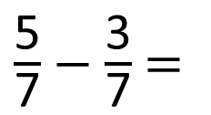
$\frac{\text{5}}{\text{7}}$ $−$ $\frac{\text{3}}{\text{7}}$ $=$
$\frac{\text{2}}{\text{7}}$
Have a think
Reduction – when something is being removed or taken away.

Slide 9
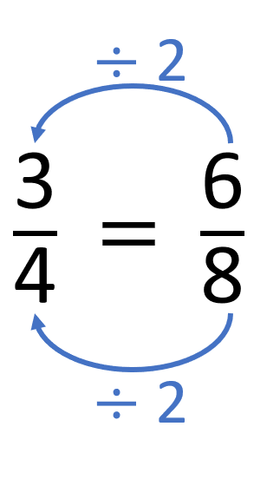
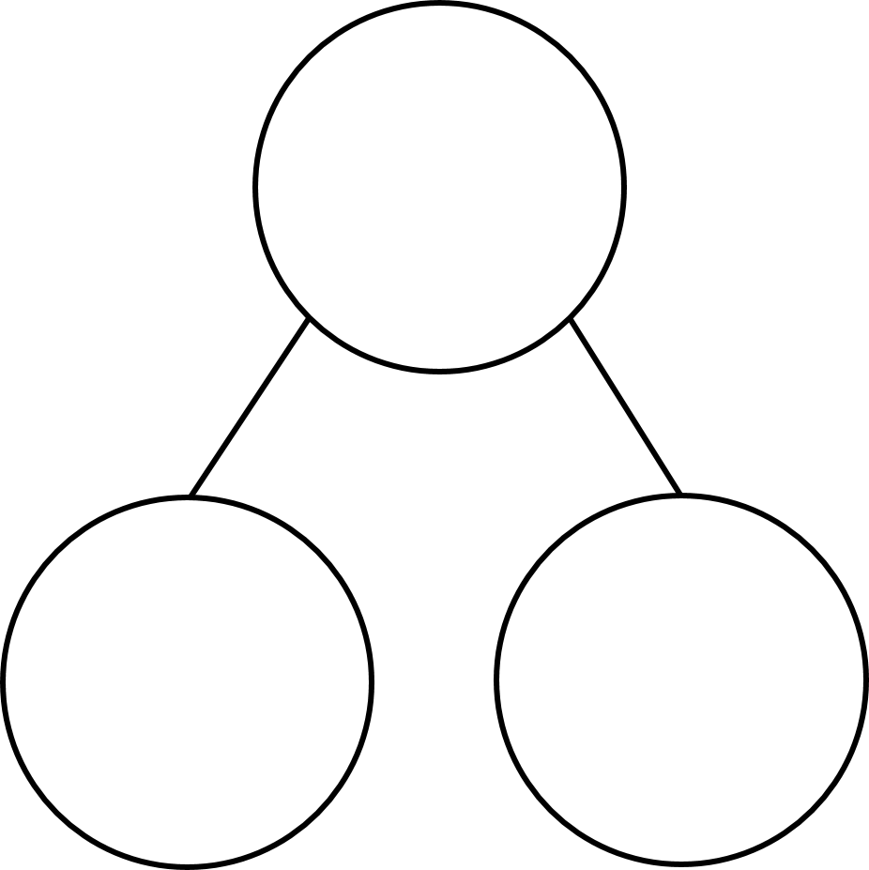
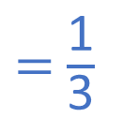
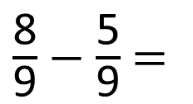
$\frac{\text{8}}{\text{9}}$ $−$ $\frac{\text{5}}{\text{9}}$ $=$
$\frac{\text{3}}{\text{9}}$
$=$ $\frac{\text{1}}{\text{3}}$
Have a think
$\frac{\text{8}}{\text{9}}$
Partitioning – splitting the whole into two or more parts
$\frac{\text{5}}{\text{9}}$
$\frac{\text{3}}{\text{9}}$

Slide 10
Have a go at questions 1 – 5 on the worksheet

Slide 11
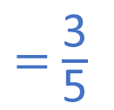

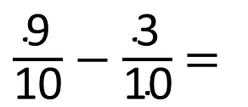
$\frac{\text{9}}{\text{10}}$ $−$ $\frac{\text{3}}{\text{10}}$ $=$
$\frac{\text{6}}{\text{10}}$
$=$ $\frac{\text{3}}{\text{5}}$
Have a think
Difference – a comparison between two sets - how much more or less/fewer

Slide 12
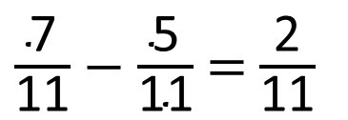
5
$\frac{\text{7}}{\text{11}}$ $−$ $\frac{\text{5}}{\text{11}}$ $=$ $\frac{\text{2}}{\text{11}}$
Have a think

Slide 13
10
$\frac{\text{10}}{\text{11}}$ $−$ $\frac{\text{3}}{\text{11}}$ $=$ $\frac{\text{2}}{\text{11}}$ $+$ $\frac{\text{5}}{\text{11}}$
Have a think

Slide 14
Have a go at the rest of the questions on the worksheet

Slide 15
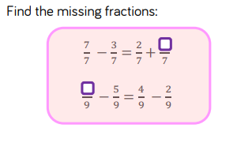

Slide 16
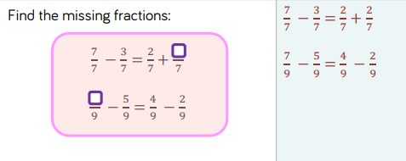

Slide 17
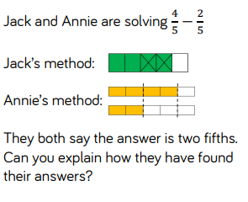

Slide 18
Answer
Jack has taken two fifths away. Annie has found the difference between four fifths and two fifths.

