Slide 1
Art
02.03.21

Slide 2
Competition!!
ART COMPETITION Northumberland County Council invites school age children within Northumberland to submit their finest art drawings of Inspirational Women from Northumberland in celebration of International Women’s Day 2021.

Slide 3
Prizes!!!
Prizes will be awarded as follows: Winner: £200 for the award winning school and £25 book voucher for the winning artist
Runner up: £100 for the runner up school and £20 book voucher for the runner up artist

Slide 4
Can you choose someone that you researched yesterday to create a piece of art work?
Will it be a portrait?
A collage?
A scene?
Will you choose more than one inspirational Northumbrian woman?

Slide 5
Ideas
Be as creative as you can! Let your imagination go wild!!
You can use pens, pencils, paint, collage materials. Whatever you choose.
I’ve put a few ideas on the next few slides to get you started. I’ve had to use photos and clipart but you can draw freehand. I’m sure you’ll have lots of your own ideas.

Slide 6
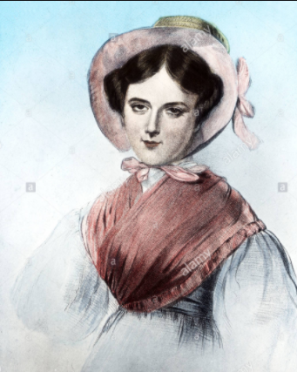
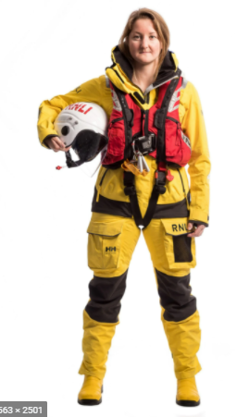
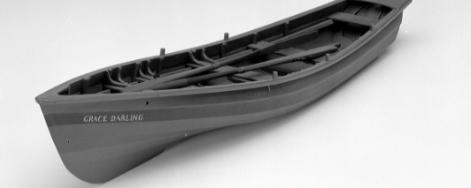
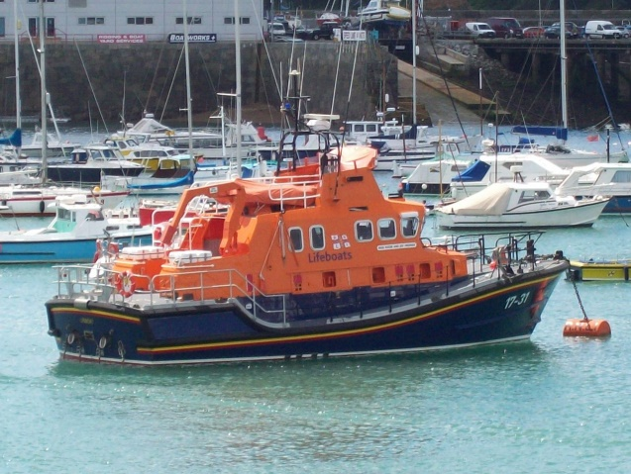
#Challengeyourself

Slide 7
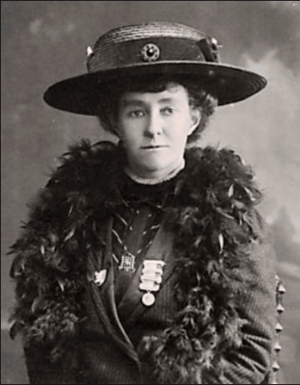
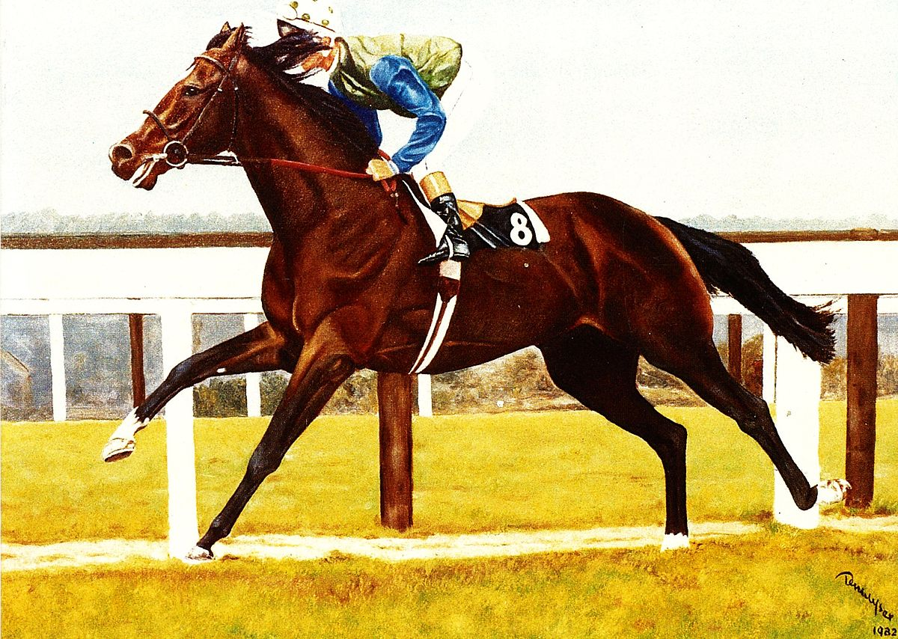
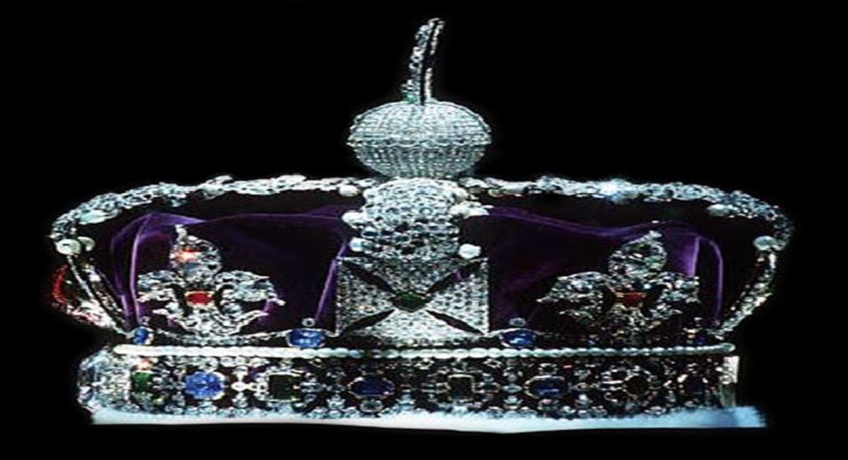

Slide 8
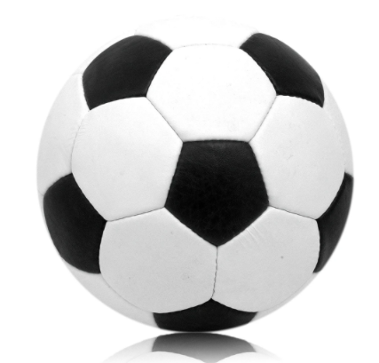
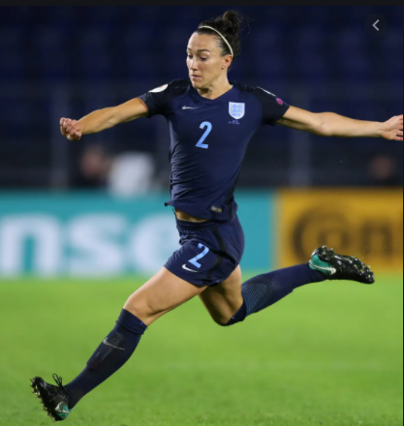
#Challengeyourself

Slide 9
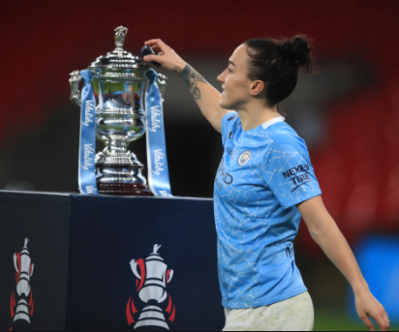
Believe and achieve Believe and achieve Believe and achieve Believe and achieve
Believe and achieve Believe and achieve Believe and achieve Believe and achieve
Believe and achieve Believe and achieve Believe and achieve Believe and achieve
Believe and achieve Believe and achieve Believe and achieve Believe and achieve
Believe and achieve Believe and achieve Believe and achieve Believe and achieve
Believe and achieve Believe and achieve Believe and achieve Believe and achieve
Believe and achieve Believe and achieve Believe and achieve Believe and achieve
Believe and achieve Believe and achieve Believe and achieve Believe and achieve
Believe and achieve Believe and achieve Believe and achieve Believe and achieve
Believe and achieve Believe and achieve Believe and achieve Believe and achieve
Believe and achieve Believe and achieve Believe and achieve Believe and achieve
Believe and achieve Believe and achieve Believe and achieve Believe and achieve
Believe and achieve Believe and achieve Believe and achieve Believe and achieve
Believe and achieve Believe and achieve Believe and achieve Believe and achieve
Believe and achieve Believe and achieve Believe and achieve Believe and achieve
Believe and achieve Believe and achieve Believe and achieve Believe and achieve
Believe and achieve Believe and achieve Believe and achieve Believe and achieve
Believe and achieve Believe and achieve Believe and achieve Believe and achieve
Believe and achieve Believe and achieve Believe and achieve Believe and achieve
Believe and achieve Believe and achieve Believe and achieve Believe and achieve
Believe and achieve Believe and achieve Believe and achieve Believe and achieve
Believe and achieve Believe and achieve Believe and achieve Believe and achieve

