Slide 1
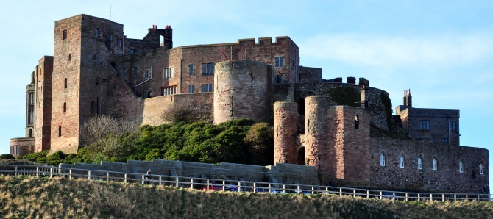
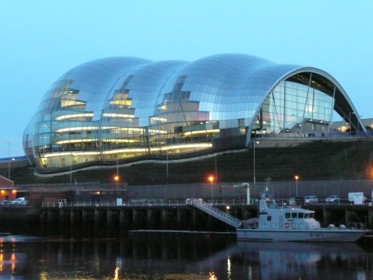
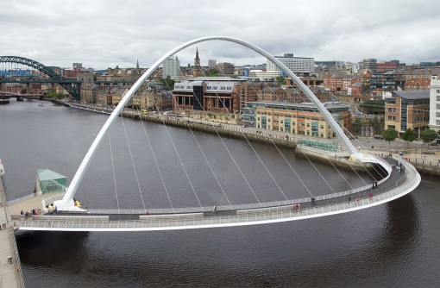
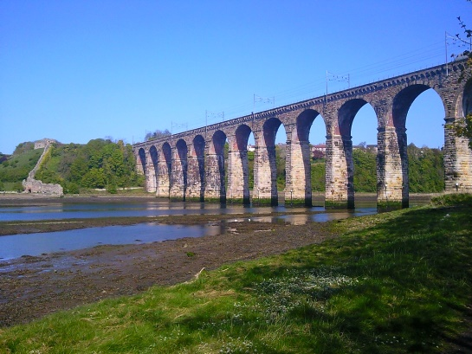
Art & Design
I can identify local examples of architecture
18.01.20

Slide 2
Vocabulary
Architect
Building
Purpose
Design

Slide 3
Review
In our last lesson we thought about these questions …
What is a building?
What can a building be used for?
What is an architect?
Discuss the questions.

Slide 4
Buildings can have many different purposes.
Where people live or stay e.g. house, flat, bungalow, hotel.
Where people work e.g. school, office, hospital, fire station, restaurant, shop.
For culture or entertainment e.g. theatre, cinema, stadium, zoo, Eiffel Tower, Sydney Opera House.
An architect is someone who designs buildings. They have to think about how the building will look, if it is fit for purpose and if it is safe.

Slide 5
Local architecture
Today we are going to think about local architecture.
Can you think of any examples that you might have seen or heard of?

Slide 6
Local architecture
Now we’ll have a look at some examples in more detail.

Slide 7
The Royal Border Bridge, Berwick
The Royal Border Bridge spans the River Tweed between Berwick-upon-Tweed and Tweedmouth .
It is a Grade I listed railway viaduct built between 1847 and 1850, when it was opened by Queen Victoria.
The engineer who designed it was Robert Stephenson.

Slide 8
The Millennium Bridge
The Gateshead Millennium Bridge is a pedestrian and cyclist tilt bridge over the River Tyne linking Gateshead and Newcastle .
It was opened on 17th September 2001 and was designed by architect Keith Brownlie.

Slide 9
The Millennium Bridge
The Gateshead Millennium Bridge lit up at night.

Slide 10
Spanish City
Spanish City first opened in 1910 as a concert hall, restaurant, roof garden and tearoom. A ballroom was added in 1920 and later a funfair. The architects were Robert Burns Dick, Charles T. Marshall and James Cackett.

Slide 11
Spanish City
After closing in 2000 and a long period of restoration, Spanish City finally reopened in July 2018. It now has a restaurant, bar, take away, tearoom and can be booked for events like weddings.

Slide 12
Cragside
Cragside is a Victorian house in Rothbury, Northumberland. It was built between 1869 -1885 for Lord and Lady Armstrong. It was the first house to be lit by hydroelectric power. The architect was Richard Norman Shaw.

Slide 13
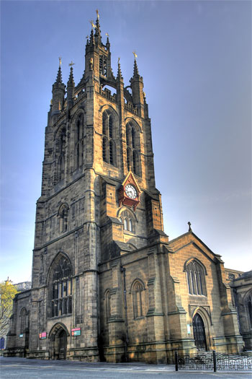
Newcastle Cathedral
.
Newcastle Cathedral is Grade I listed and dates from the early
14th century.
It has been developed over the centuries by many architects such as Daniel Garrett, John and Benjamin Green, John Dobson, and George Gilbert Scott.

Slide 14
Task
.
We have only looked at some of the many beautiful buildings that we have in the North East. There are so many more Castles, bridges and buildings to discover. After the lesson, you might want to research some more.
Today, can you:
choose your favourite building.
Can you create a sketch of your favourite building and explain why you have chosen it?
Where there any particular features of architecture that appealed to you?

