Slide 1
I can add 2 or more fractions
02.03.21

Slide 2
Vocabulary
Fraction
Amount
Whole
Addition
Numerator
Denominator

Slide 4
4 $+$ $=$ 9
4 $+$ $=$ 13
4 $+$ $+$ 5 $=$ 15
$\frac{\text{13}}{\text{7}}$ $=$ whole $+$ sevenths
$\frac{\text{3}}{\text{5}}$ $+$ $\frac{\text{1}}{\text{5}}$ $=$

Slide 5
5
4 $+$ $=$ 9
4 $+$ $=$ 13
4 $+$ $+$ 5 $=$ 15
$\frac{\text{13}}{\text{7}}$ $=$ whole $+$ sevenths
$\frac{\text{3}}{\text{5}}$ $+$ $\frac{\text{1}}{\text{5}}$ $=$
9
$\frac{\text{7}}{\text{7}}$
6
$\frac{\text{6}}{\text{7}}$
1
6
$\frac{\text{4}}{\text{5}}$

Slide 7
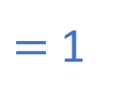
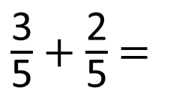
$\frac{\text{3}}{\text{5}}$ $+$ $\frac{\text{2}}{\text{5}}$ $=$
$\frac{\text{5}}{\text{5}}$
$=$ 1
Have a think

Slide 8
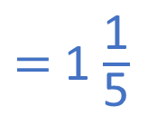
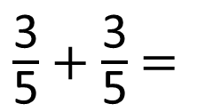
$\frac{\text{3}}{\text{5}}$ $+$ $\frac{\text{2}}{\text{5}}$ $=$
$\frac{\text{5}}{\text{5}}$
$=$ 1
$\frac{\text{3}}{\text{5}}$ $+$ $\frac{\text{3}}{\text{5}}$ $=$
$\frac{\text{6}}{\text{5}}$
$=$ 1 $\frac{\text{1}}{\text{5}}$
Have a think

Slide 9
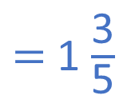
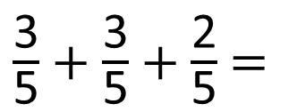
$\frac{\text{3}}{\text{5}}$ $+$ $\frac{\text{3}}{\text{5}}$ $+$ $\frac{\text{2}}{\text{5}}$ $=$
$\frac{\text{8}}{\text{5}}$
$=$ 1 $\frac{\text{3}}{\text{5}}$
Have a think

Slide 10
$\frac{\text{3}}{\text{5}}$ $+$ $\frac{\text{3}}{\text{5}}$ $+$ $\frac{\text{2}}{\text{5}}$ $=$
$\frac{\text{8}}{\text{5}}$
$=$ 1 $\frac{\text{3}}{\text{5}}$
Method A
Method B

Slide 11
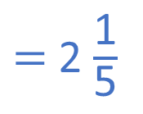

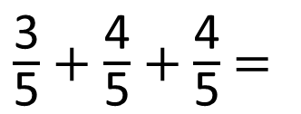
$\frac{\text{3}}{\text{5}}$ $+$ $\frac{\text{4}}{\text{5}}$ $+$ $\frac{\text{4}}{\text{5}}$ $=$
$\frac{\text{11}}{\text{5}}$
$=$ 2 $\frac{\text{1}}{\text{5}}$
Have a think

Slide 12
Have a go at questions 1 – 5 on the worksheet

Slide 13

2
$\frac{\text{4}}{\text{7}}$ $+$ $\frac{\text{2}}{\text{7}}$ $=$ $\frac{\text{6}}{\text{7}}$

Slide 14
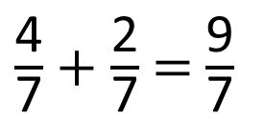
2
$\frac{\text{4}}{\text{7}}$ $+$ $\frac{\text{2}}{\text{7}}$ $=$ $\frac{\text{6}}{\text{7}}$
5
$\frac{\text{4}}{\text{7}}$ $+$ $\frac{\text{2}}{\text{7}}$ $=$ $\frac{\text{9}}{\text{7}}$
Have a think

Slide 15
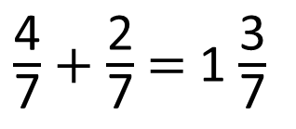
6
$\frac{\text{4}}{\text{7}}$ $+$ $\frac{\text{2}}{\text{7}}$ $=$ 1 $\frac{\text{3}}{\text{7}}$

Slide 16
6
15
$\frac{\text{4}}{\text{7}}$ $+$ $\frac{\text{2}}{\text{7}}$ $+$ $\frac{\text{5}}{\text{7}}$ $=$ $\frac{\text{15}}{\text{7}}$ $=$ 2 $\frac{\text{1}}{\text{7}}$
Have a think

Slide 17
Have a go at the rest of the questions on the worksheet

Slide 18
Mo and Teddy are solving:
Mo
Teddy
Who do you agree with?
Explain why.
$\frac{6}{13}$ + $\frac{5}{13}$ + $\frac{7}{13}$
The answer is 1 and $\frac{5}{13}$
The answer is$\frac{18}{13}$

Slide 19
Mo and Teddy are solving:
Mo
Teddy
Who do you agree with? They are both correct
Explain why. Mo has added 6 7
13 + 13 to make 1 whole and then added 5
13
$\frac{6}{13}$ + $\frac{5}{13}$ + $\frac{7}{13}$
The answer is 1 and $\frac{5}{13}$
The answer is$\frac{18}{13}$

Slide 20
Draw a bar model if you are not sure!

