Slide 1
English
Poetry
Tuesday 2nd March

Slide 2
Speaking and listening
https://www.bbc.co.uk/newsround/news/watch_newsround
Watch Newsround.
What did you find out?
Did anything puzzle you?
Would you like to discuss something more or find out more about it?

Slide 3
SPaG Starter
Write one perfectly punctuated sentence about the Creeper

Slide 4
Words with the s sound spelt sc

Slide 5
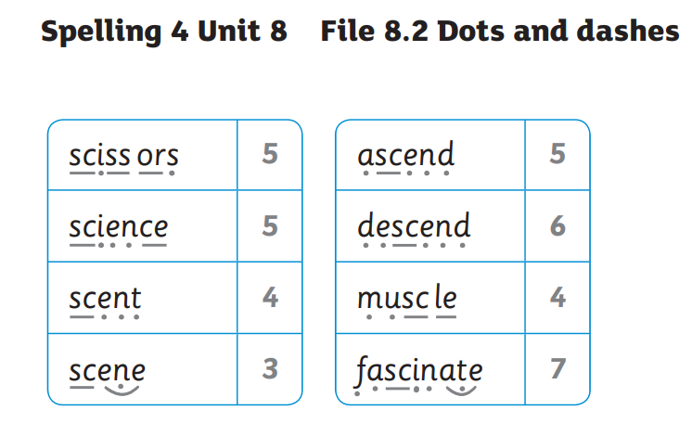
Answers

Slide 6
I can recognise the features of a simple cinquain poem.

Slide 7
Poetic terms
How many poetic terms can you remember from yesterday?

Slide 8
Read These Cinquain Poems
Can you notice anything similar about the features?
Watermelon
Sweet, juicy
Licking, slurping, sucking
Dripping down my arm
Tasty
Rain
Dismal, grey
Falling, beating, drumming
Hammering on the roof
Shower
Unicorn
White, majestic
Galloping, nuzzling, braying
A trail of magic
Wonder

Slide 9
What Is a Didactic Cinquain Poem?
This is a very simple style of cinquain. Instead of focusing on syllables, it focuses on words. Don’t confuse it with a Haiku!
The first line is one word which is the title of the poem. For
example, summer.
The second line contains two words which are adjectives that describe the title. For example, sunny, hot.

Slide 10
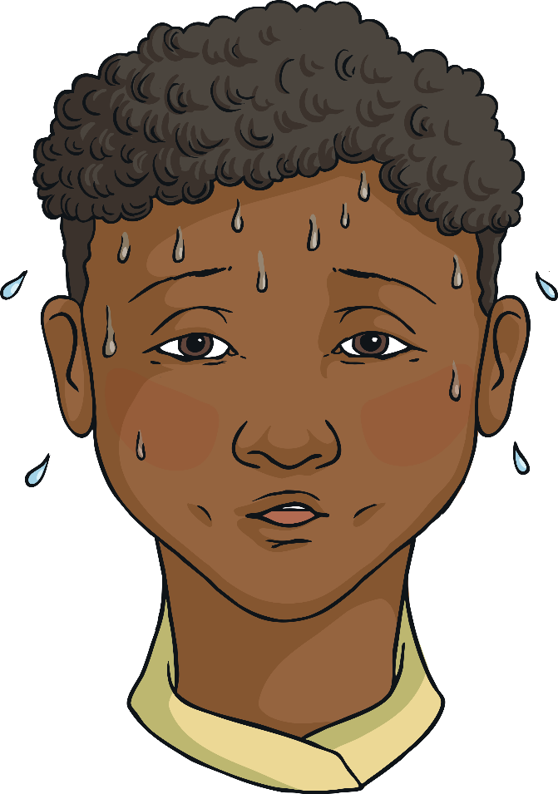
What Is a Didactic Cinquain Poem?
The third line has three words that tell the reader more about the subject of the poem or shows action. Many times these words end with “ing.” For example, sweltering, swimming, dozing.
The fourth line has four words that show emotions about the subject of the poem and may be individual words or a phrase. For example, basking in the sun.

Slide 11
What Is a Didactic Cinquain Poem?
The fifth line is one word that is a synonym of the title or is very similar to it. For example, Holiday.
Summer
Sunny, hot
Sweltering, swimming, dozing
Basking in the sun
Holiday

Slide 12
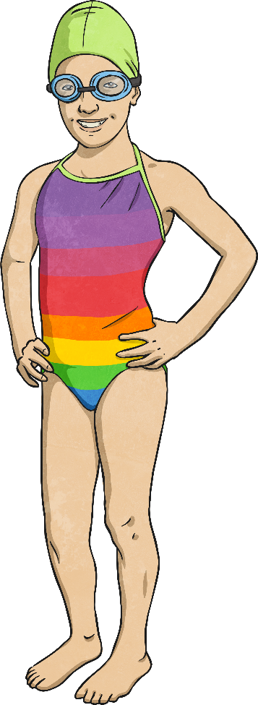
Summer Cinquain
Summer
Sunny, hot
Sweltering, swimming, dozing
Basking in the sun
Holiday
One Word
Two Words
Three words
Four Words
One word

Slide 13
Shared Writing
We are going to write a cinquain poem together as a class. The topic of our poem will be Thunderstorm.
Close your eyes and think of as many words to do with a thunderstorm as you can.
When you are ready, write them down.
Thunderstorm

Slide 14
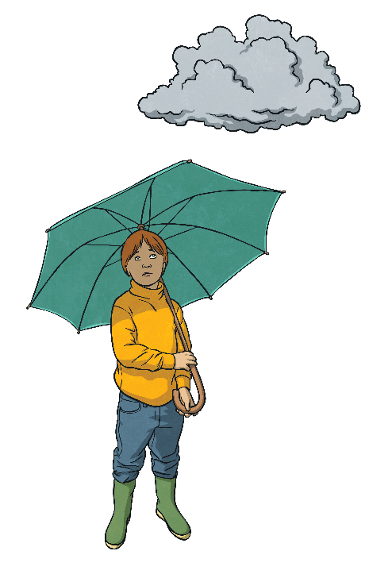
Shared Writing - Thunderstorm Poem
_____________
________________
____________________
_____________________
________
One Word
Two Words
Three words
Four Words
One word

Slide 15
Task
Now you are ready to write your own cinquain poem. The topic of your poem will be inspirational women from Northumberland.
Close your eyes and think of as many words to do with inspirational women as you can. Think about what you researched yesterday to help you.
When you are ready, write down your ideas .
Use the next slide to remind yourself how to lay out your cinquain.
Inspirational women from Northumberland

Slide 16
Inspirational Women from Northumberland Poem
_____________
________________
____________________
_____________________
________
One Word
Two Words
Three words
Four Words
One word

